Slide 1
Definition and types of Nurseries
Nursery is a place where young plants and trees are cultivated and grown.
A place where young trees or other plants are raised for transplanting, for
sale, or for experimental study
A nursery is a place where plants are propagated and grown to usable size
Nurseries are places where seedlings are raised for planting purposes.
A plant nursery is a place where young plants are grown and cared for.

Slide 2
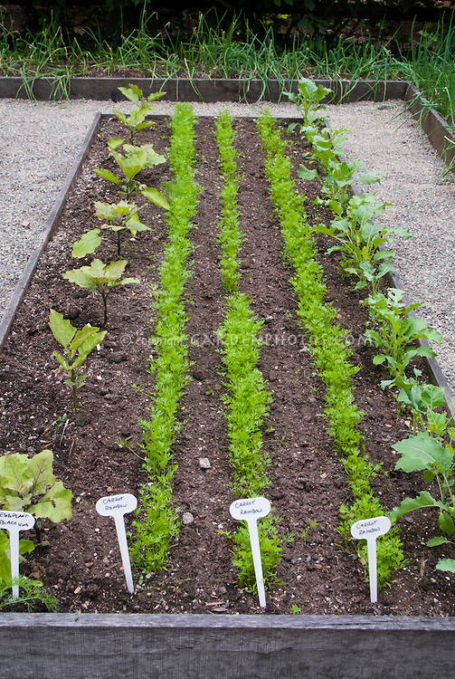
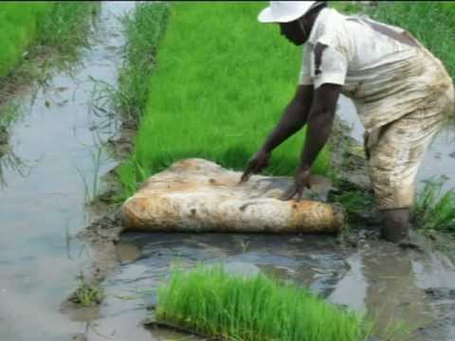
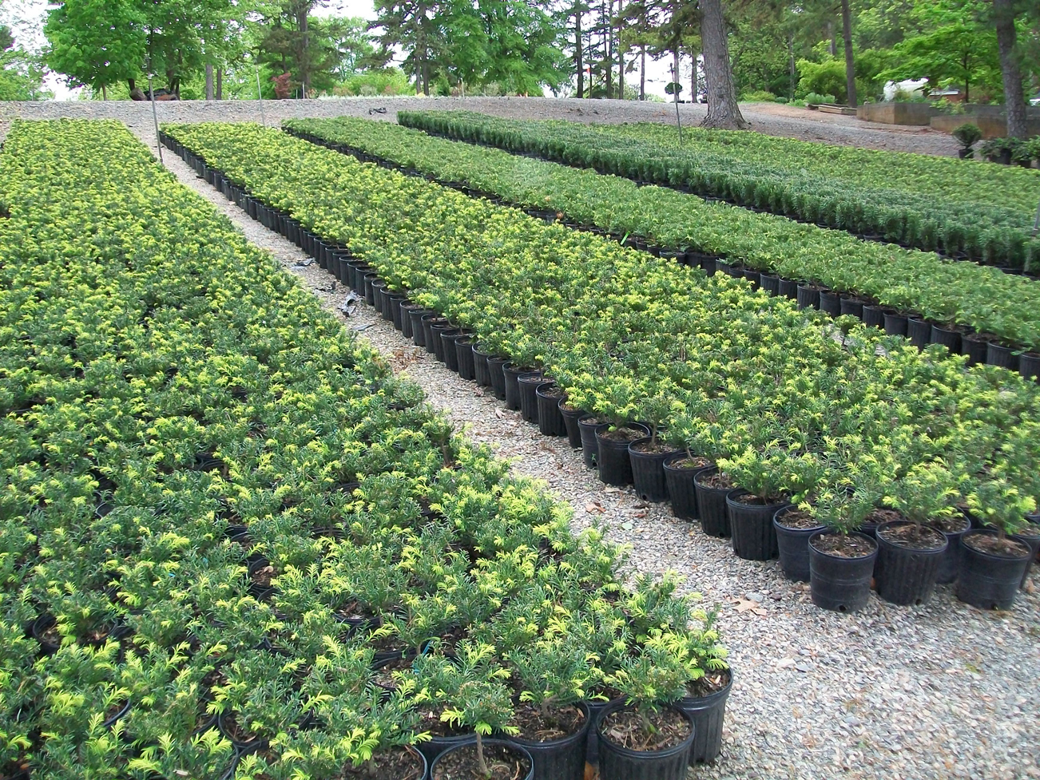

Slide 3
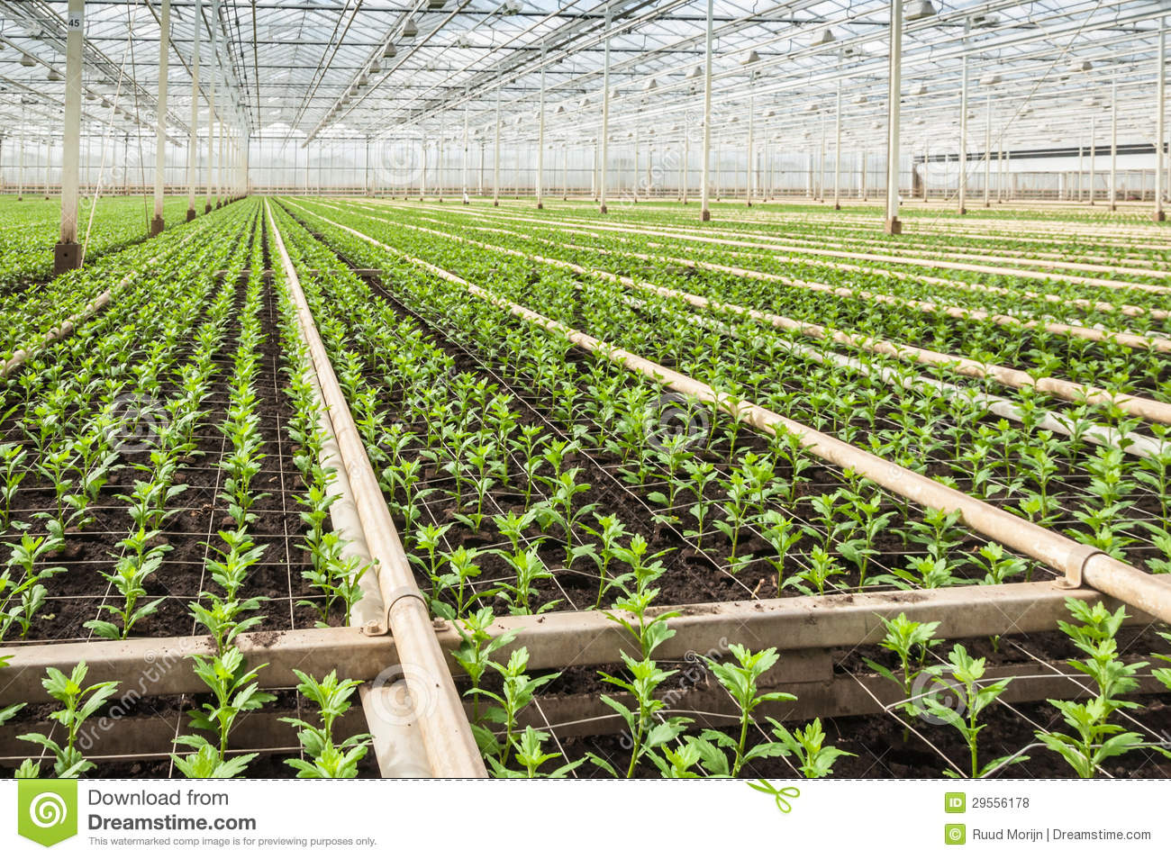

Slide 4
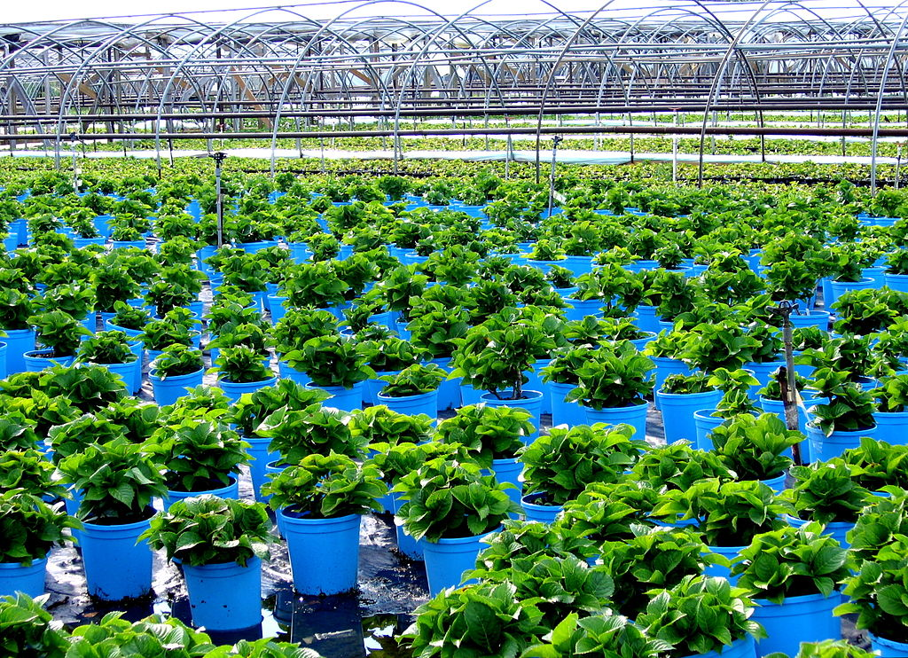

Slide 5
LOCAL CONCEPT OF NURSERIES
Bithal or Paniali(y)....Wet bed Paddy crop nursery
Dahri……Dry bed Paddy crop nursery
Thal/Paneri……….Chilli bed

Slide 6
Wet nursery
This is widely used in areas where water is abundant. The seed bed is usually prepared 25 to 35 days before trans­planting. Steps involved in raising wet bed seedlings are as follows
Land where both irrigation and drainage can be controlled should be selected for seed bed. The land should be fertile and free of excess salts or other soil problems.
The seed bed area is ploughed twice either in dry or wet conditions and then puddle by giving two or three more ploughings. After 10 days, the field is again ploughed twice and leveled.

Slide 7
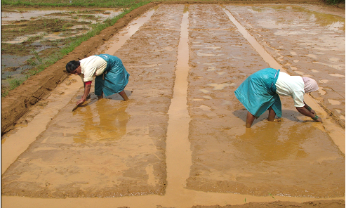
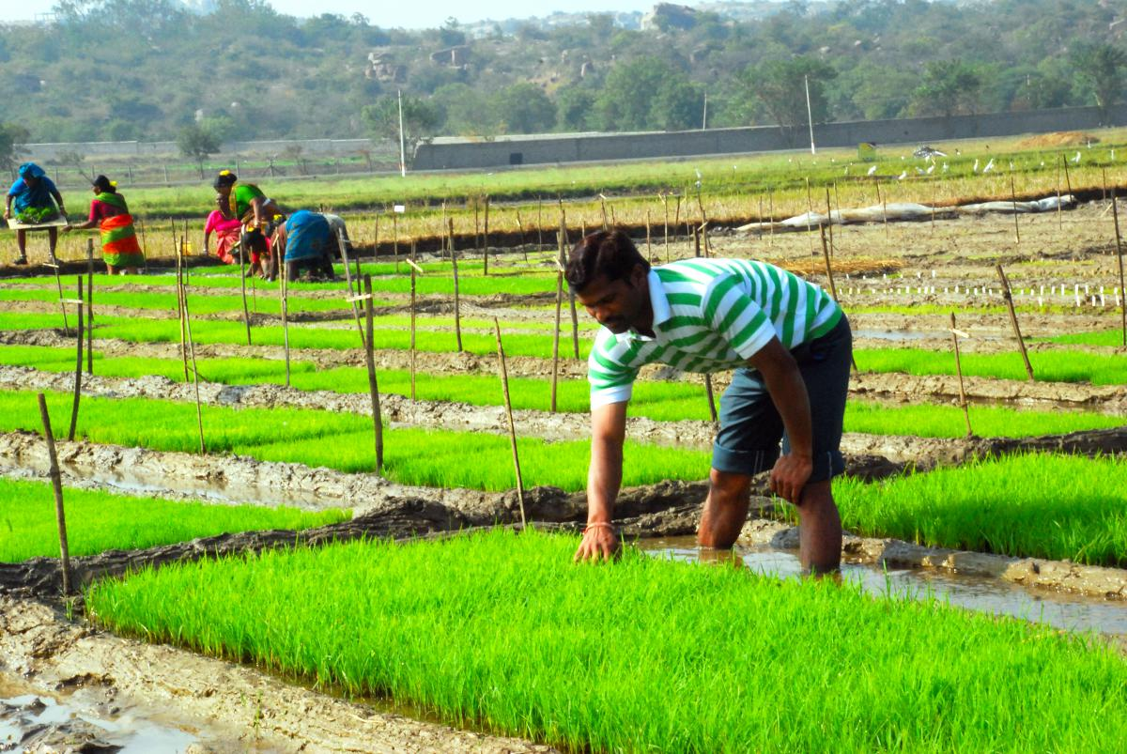

Slide 8
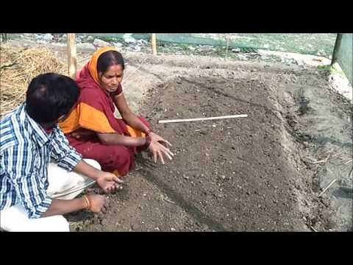
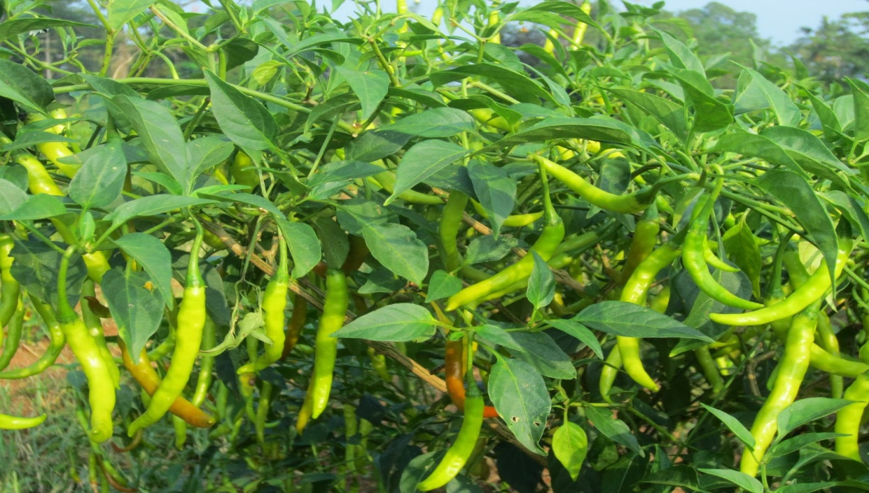

Slide 9
Types of Nurseries –
Nurseries are categorized in different ways.
1. According to time duration nurseries are classified in two types:
Temporary nursery – This type of nursery is developed only to fulfill the requirement of the season or a targeted project. The nurseries for production of seedlings of transplanted vegetables and flower crops are of temporary nature. Like wise temporary arrangement for growing forest seedlings for planting in particular area can also be done in temporary nursery.
Permanent nursery – This type of the nursery is placed permanently so as to produce plants continuously. These nurseries have all the permanent features. The permanent nursery has permanent mother plants. The work goes on continuously all the year round in this nursery.

Slide 10
2. According to type of plants produced, nurseries are classified into following types:
Fruit plant Nurseries: - In this nursery seedlings and grafts of fruit crops are developed.
Vegetable nurseries: - In this nursery seedlings of cauliflower, cabbage, brinjal and tomato are prepared.
Flowers plants nurseries (Ornamental plant nurseries):- The seedlings of flowering plants like gerbera, carnation, petunia, salvia, rose, chrysanthemum, coleus, aster, dianthus are developed in this nurseries.
Forest nurseries: - The seedlings of plants useful for forestation like pine, oak, teak, eucalyptus, casuarinas are prepared and sold.
Miscellaneous nurseries: - In such type of nurseries plants with great economic value, rare and medicinal, herbal plants are propagated. In this nursery plants like geranium, rose, calendula, and marigold are propagated. Planning of nursery One has to decide which type of nursery is to be started. At the same time the durations and type of plants propagated should be finalized.

Slide 11
3. According to type of plants produced
Retail nurseries
Wholesale nurseries
Private nurseries
Mail order nurseries
1. Retail nurseries raise plants for sale to the general public. These places are small, locally owned nurseries that sell seasonal, annual or ornamental trees.
2. Wholesale nurseries usually grow plants in bulk for the purpose of selling to large extent to the clients.
3. Private nurseries grow plants exclusively for a single client
4. Mail order nurseries: Privately owned, retail and wholesale businesses may all be involved in mail order businesses.

Slide 12
Physical resource for nurseries
Nursery like any other enterprise requires certain resources. The criteria for selection of products also depend on these resources.
Some of these physical resources are given below.
Land: Land is the basic and fundamental physical resources for plant nursery. The area available must be considered before planning the nursery and product. Soil should be well drained, porous and light to medium in texture. Soil pH should be 6.5-7.5
2. Irrigation Facilities: Required land with sufficient and assured supply of irrigation is the most important basic resource.
Labour:

Slide 13
Selection of site
Site is the basic requirement of a nursery. Site is a place upon which one can produce seedlings of plants. Qualities of a good site are:
Nearness of road
Near a habitat
Suitable climate
Neither shady nor exposed area
Sufficient sunlight
6) Good irrigation facilities
7) Good soil condition
8) Good transport facility

Slide 14
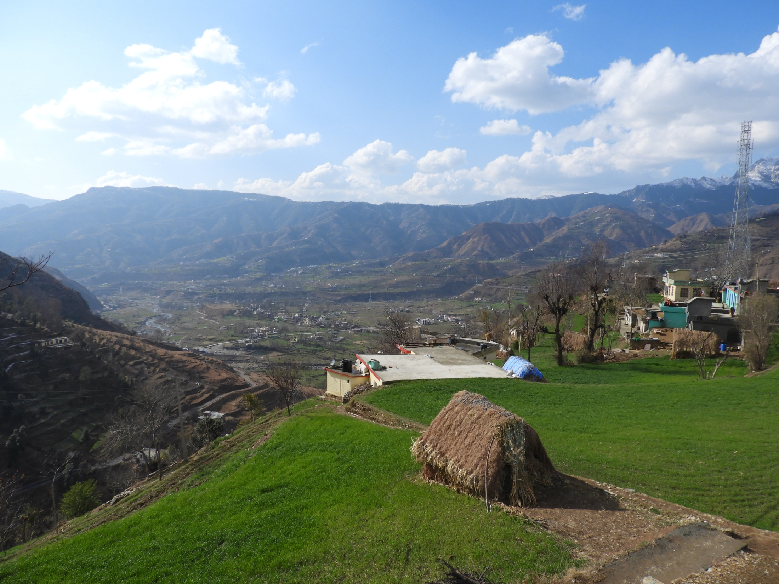
THANK YOU
Dr. ANWER SHAH
Department of Botany
P.G. College Rajouri

